Slide 1

[ AM27 2020 ] Santorini project
AM27

Slide 2
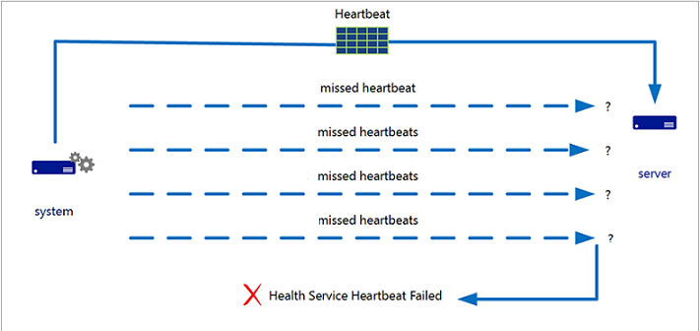
Heartbeat system – both ways

Slide 3
Patterns: producer/consumer
Producer thread
Used in the client:
To read server messages
To capture user inputs
While keeping the main process
free from I/O operations
Message queue
Consumer thread

Slide 4
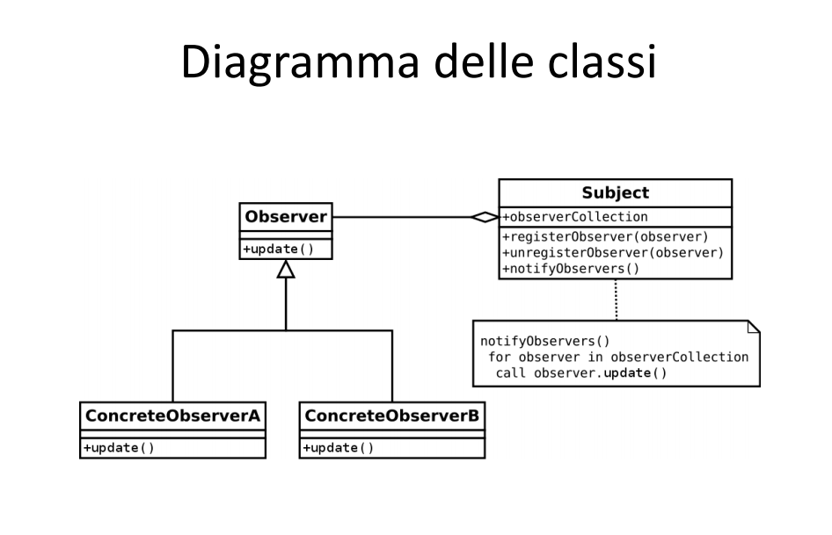
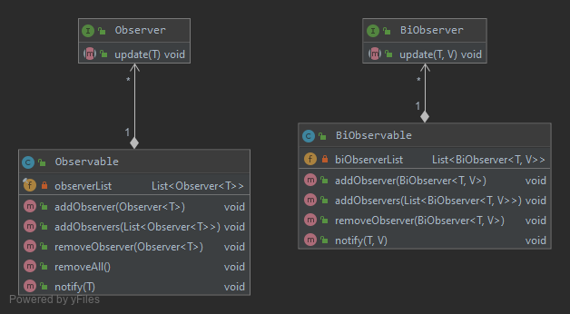
Patterns: observer
Used:
Between model (observable) and view (observer)
Between controller (observer) and view (observable)
Between gods (both observable and observers)

Slide 5
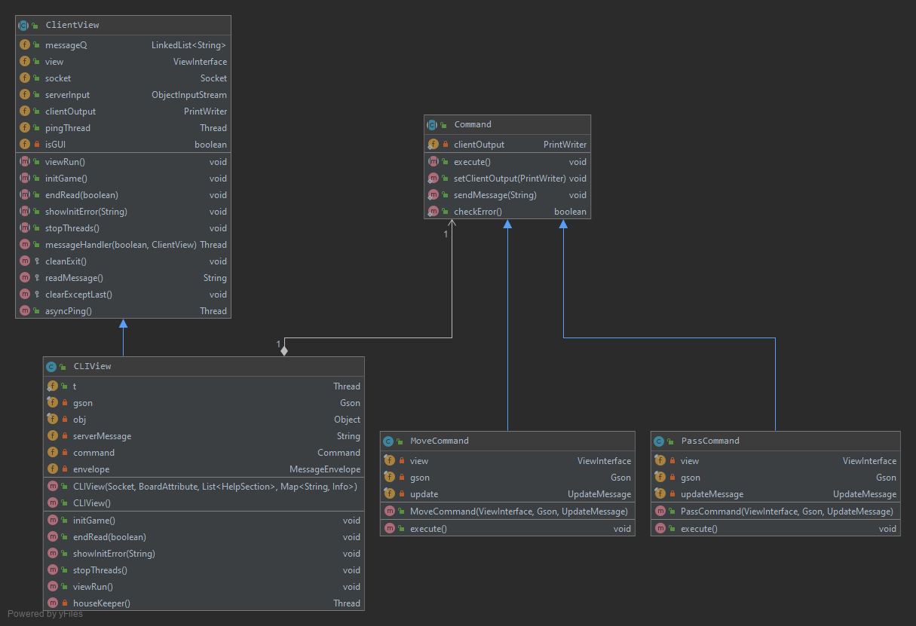
Patterns: command
Used to handle the user inputs and server messages in the client

Slide 6
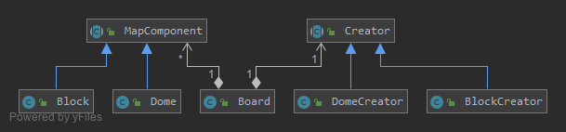
Patterns: factory method
Used to create map components
(a bit overkill)

Slide 7
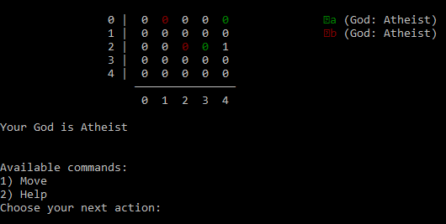
Some additional and experimental functions
(out of specifications – server & CLI)
Games without gods

Slide 8
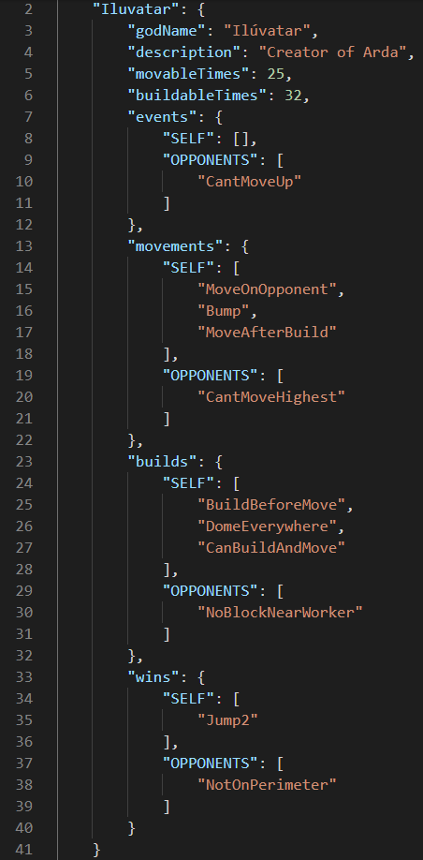
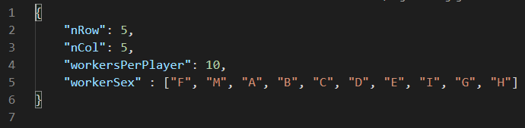
Some additional and experimental functions
(out of specifications – server & CLI)
Updatable configurations
(exported at first use in .json format)
Adding/removing gods
Modifying the board dimensions
Changing the number of workers per player

Slide 9
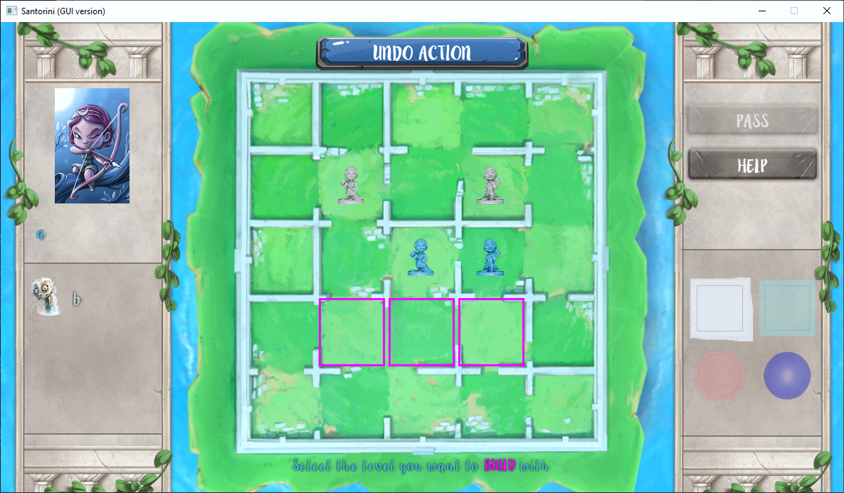
Actions are allowed only if previously validated by the server

Slide 10



Depth-first search: Limus vs. Triton
Reachable cell
(super)
Non-buildable
cell
Buildable cell
Current
hypothesized
position

Slide 11
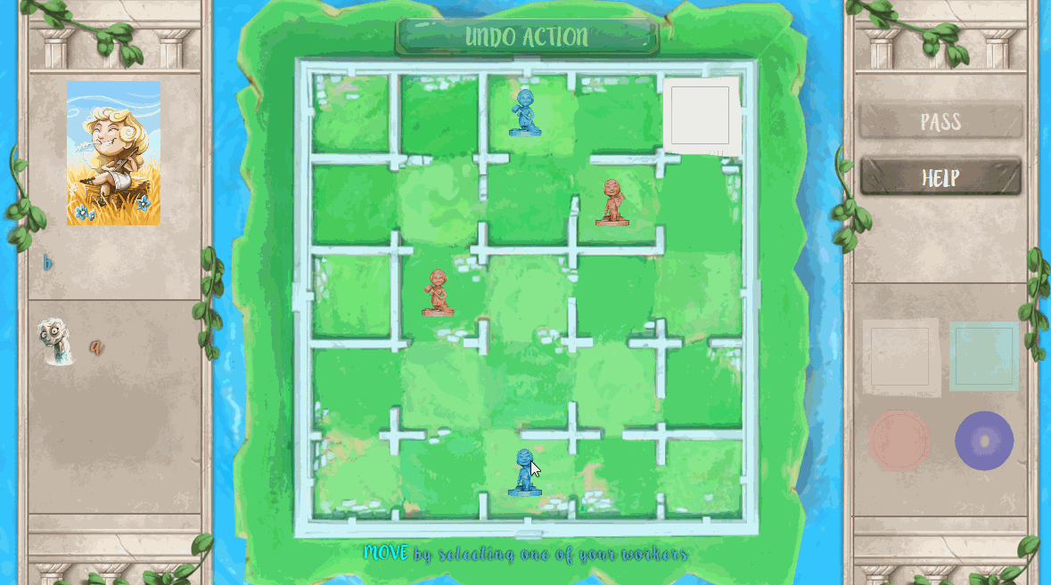
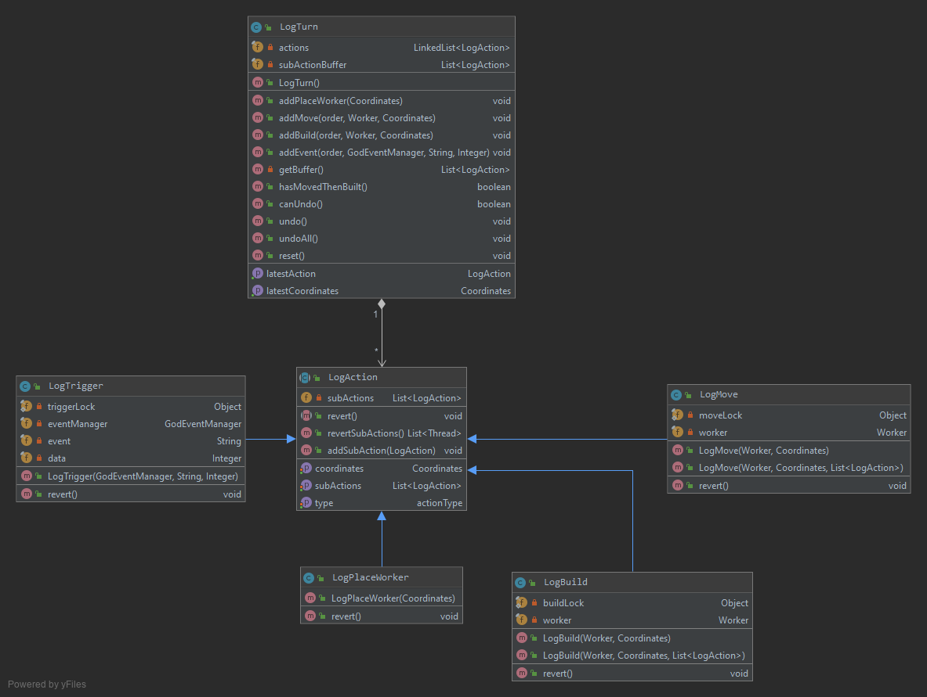
Advanced functionalities: undo

Slide 12
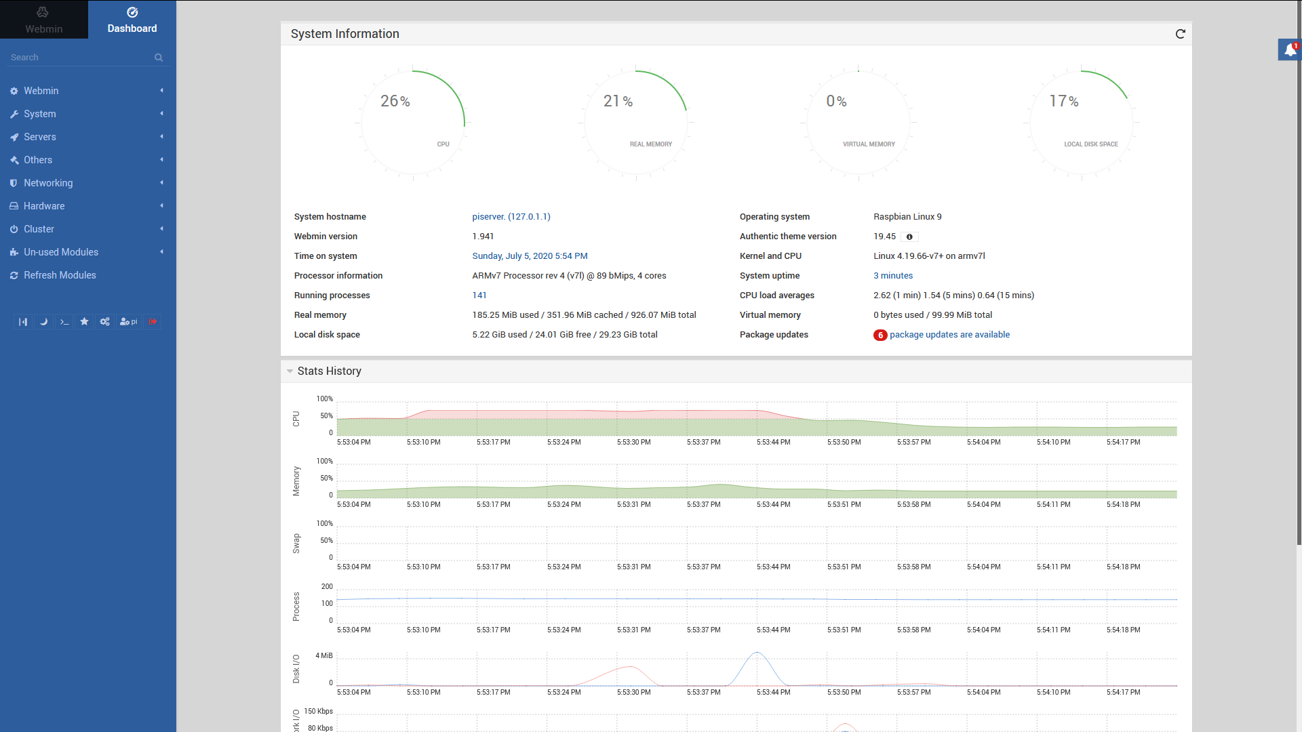
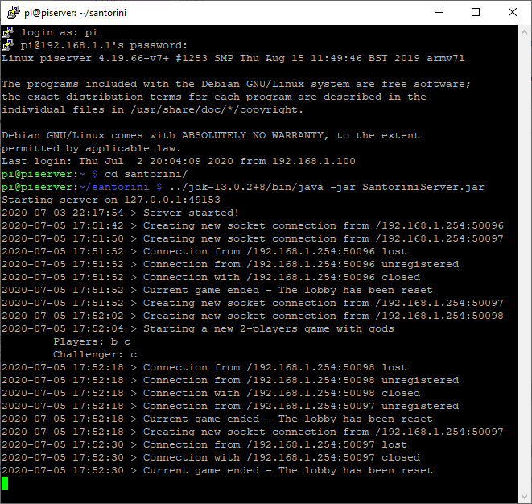
Server version is running on a Raspberry pi

Slide 13
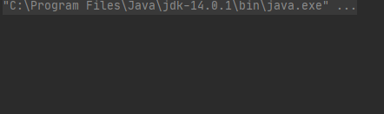
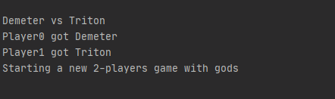
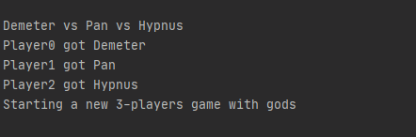
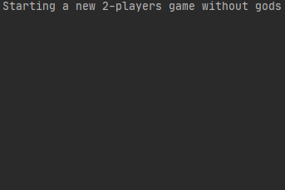
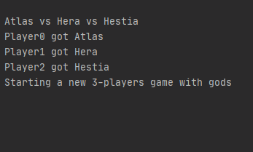
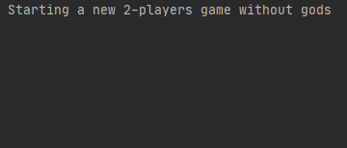
2 players – no gods
2 players – Demeter vs Triton
3 players – no gods
3 players – Demeter vs Pan vs Hypnus
Some random game examples
10x1 board
8x8 board, 5 worker per player
10 workers per player

